Slide 1

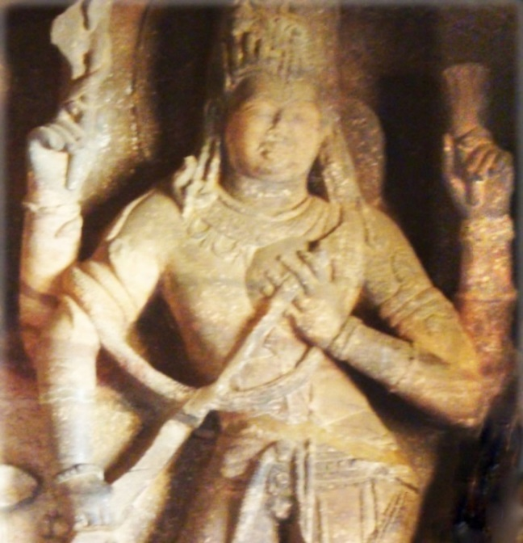
Know How to Build Team and
Increase Your Productivity
Attitude for Success Part 2
Teambuilding to Excel
Through Synergy
Preparing for Promotion?
Can Training Ensure Success?
Yes!
Training is like being on a train to reach your destination.
How? By Knowledge, Skill and Attitude for Success thro’ Synergy to Increase Productivity.
Teambuilding Is Cross-functional to Achieve a SMART goal.
Synergy is when components complement. Ek aur ek gyarah (1 + 1= 11).
.
Yamah Siddhayah
P.K.Ratho

Slide 2
Concern for Self Vs Synergy from
Empathy for Team
Concern for Self. |  | Empathy for Team
Attitude | Logic / Argument | Attitude | Logic / Argument
Priority: 1st. Conviction 2nd.Self 3rd.Role 4th. Task 5th.Commitment 6th.Trust Truthful / Reality. Increase IQ. |  | Reverse priorities. High IQ and EQ makes one SMART, optimistic, confident, assertive; ensures employment / promotion.
Criticise, blame | Follow ‘Rules of Conduct’: Discipline | Empathy facilitates team. Praise prevents opposition. | Attachment, greed, anger are due to false knowledge strengthen mutually.
Intolerant, angry | Why tolerate fools? Win by logic. | Reach out, belong; cooperate to team-up. | Selfishness is a sin. Esteem comes from helping.
Introvert, intuition | Genius is from intuition. Others do not practise empathy. | Social, accepting: Prevent negative emotions. | Happy (extrovert) by fourfold behaviour.
False Conviction Who bothers for long-term effect? |  | Truthfulness: Result is according to action; follows from cause-and-effect.
Scheming, cunning | Cleverness is quicker and better. | Adult ego: Brave, upright | Finds out truth, learns and succeeds
Pride, bias | Holier than thou | Truthful, by cause-effect | Fact is true; truth wins; prevents lie.
Afraid, adaptive | Bow to strong, rule over weak | Objective, unemotional | Be open. Praise good qualities before criticism. Let him realise the truth.
Lack of Commitment |  | Honesty: Basis of all deals; synergy from teambuilding
Self-centred, competitive | Game-playing: fake it until you make it (?) | Supervising, Guiding: Synergy of mentor-mentee. | Truth and honesty enable to take the right decision and develop cooperation.
Rule based, assertive | Success: Better safe than never | Forgive, Help | Involve, act on SWOT. Develops reliability.
Achieve by any means | Survival of the fittest | Bene(good)fit, build team | Components must complement.
Unproductive: Egoist |  | Control senses. Grow through Synergy of Team.
Independent, directing | He who pays calls the tune. (?) | Non-verbal, responsive | Action (openness) speaks louder.
Impulsive, restless | I follow my heart. | Business-like, persuade | Show interest, not reason.
Possessive: For recognition |  | Non- possessive: Esteem from service
Attached, possessive | Emotions make life worth living. Why few practise empathy? | Delegate, empower | Non- possessive controls senses; achieves teambuilding and potential.

Slide 3
Leadership and Teambuilding
Compete to create; cooperate to succeed
Team Be Productive (Synergy of Body and Mind and of Team)
For Leader To Be Versatile and Innovative
Innovation starts with a problem (for Adaptive) / challenge (for innovative), generates ideas and converts the best idea to add value.
Innovator is a genius: Adult ego (Sat-tva) predominant followed by Nurturing Parent ego next high.
Be curious, intuitive and playful (try out) as a child; find facts (Reality).
Be analytical, logical (true cause-and-effect) and accurate (digital)
Nurturing Parent ego Adapted ego
Adult (Super) ego Parent Ego Child ego (Id)
(Sat-tva) (Self / Rajas) (Tamas)
Adaptive (clever) continuously tries to adapt; develops Synergy of Body and Mind and of Team: Nurturing Parent ego predominant followed by Adapted ego next high.
Relationship defines roles; manage motives and egos. Ideal is by affiliation.
Bene(good)fit develops interest and secures involvement.
Empathy is prerequisite to teambuilding.
Nurturing Parent ego Adapted ego
Adult (Super) ego Parent Ego Child ego (Id)
(Sat-tva) (Self / Rajas) (Tamas)

Slide 4
Teambuilding By Storming, Forming, Norming and Review
Teambuilding by Storming, Forming, Norming and Review
Teambuilding by
Managing Change
Members’ roles complement; appreciate each other’s role . Feasibility study, investigation and report prevent conflicts.
Accommodating the motives, egos and personalities is through ‘storming’, ‘forming’, ‘norming’ and ‘reviewing’. Empathy facilitates bene(good)fit in each stage.
Involve team; manage change:
Storming: Due to inadequate information, knowledge or both.
Forming: Setting SMART goal and complementing.
Norming: Setting standard operating procedure (SOP), system (including quality control), managing change, celebrating (praising) wins, modifying attitudes and producing the desired output.
Reviewing includes versatile, foresight, sharpness, tactics and revising the standard operating procedure when conditions change.
Group cannot manage the change if it does not have the expertise.
Change needs new system, effort, leader, resource and force. Easy when followers believe that it is they who want the change.
If a common goal is not visible, search for an overarching goal or a common vision.
Responsibilities and powers be delegated together according to roles. Resources, skill and power give ability to respond. He who does not exercise the power, nor delegates, cannot achieve goal.
Monitoring and control should be by the leader. Everybody prospers when the company or the team prospers.
Project management is by coordination; control is by exception.

Slide 5
Model of Startup Team to Excel
Input: Degrees of activities
‘Glossary’ in the manual / ‘Help’ menu of software ensures correct input of degrees of activities.
Model: Software
Entrepreneurship is through synergy of the three synergies: Synergy of body and the mind; of the team; and of analytical and intuitive faculties. These are along three axes.
Output shows degrees of attitudes to be modified to achieve success through increased productivity / entrepreneurship.
Output:
Profile of Needs / Motives;
Profile of Egos / Attitudes
Professional Personality
Mental Blocks and their Removal
Activities to Develop Synergy of -
Body and Mind
Team
Analytical and Intuitive Faculties
.
Genius
Synergy for Success: Entrepreneur
Synergy of
Body and Mind
For further information and online training - Contact us: 1. www.buildbestvalues.com
2. P.K.Ratho, 0674-2951703 (M) 9437490303
3. email: pkratho@hotmail.com
Synergy of
Team

